Slide 1
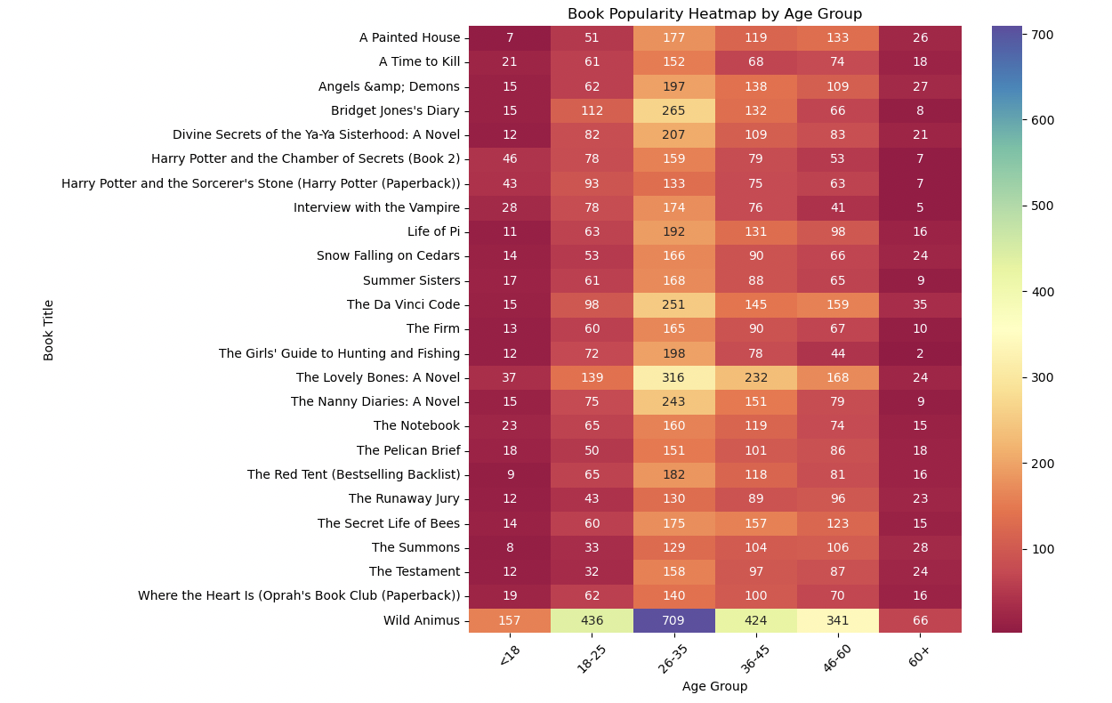
Book Popularity Across Age Groups and Authors

Slide 2
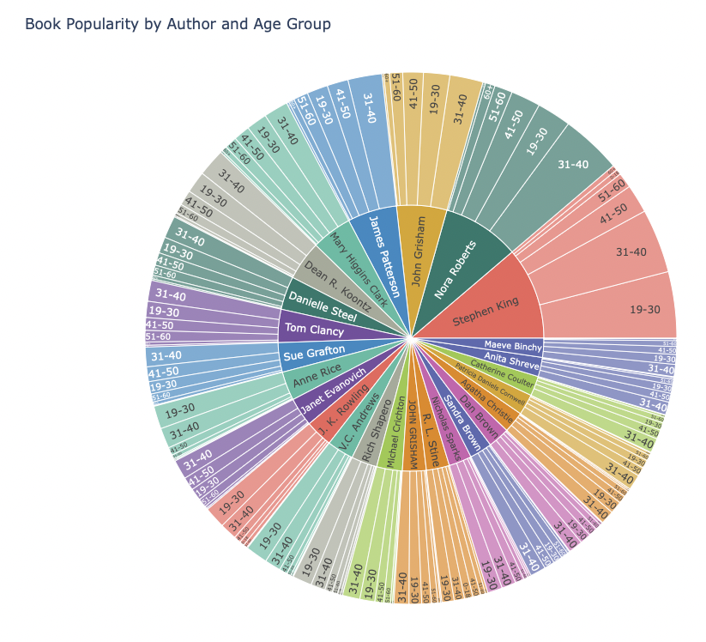
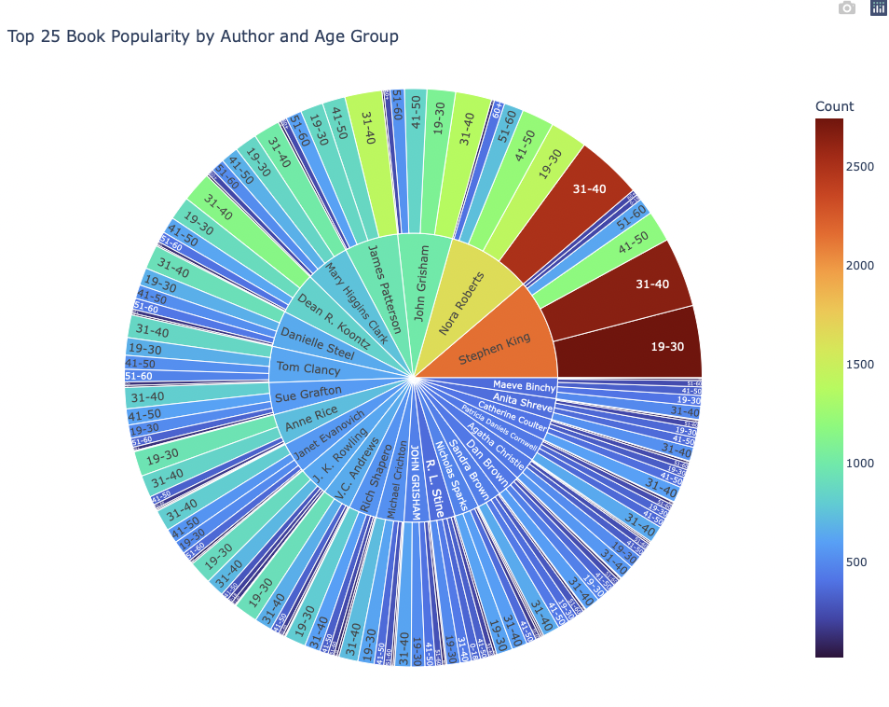
I wanted to look into this further including authors as well as age groups

